Slide 1


TP558 - Tópicos avançados em Machine Learning Federated Learning
Hanieh Memarian
hanieh.memarian@dtel.inatel.br

Slide 2
Outline
Introduction
Definition & Development of FL
Challenges
Article
Future works & Conclusion
5
Background of Machine Learning
Basic problem
What is FL
Why is FL Useful
Development Idea of FL
Definition of FL
Privacy Protection
Communication Cost
System Heterogeneity
Unreliable Model Upload
Federated Averaging Algorithm
Simulation Results
Conclusion
Future Directions
4
3
2
1

Slide 3
Introduction

Slide 4
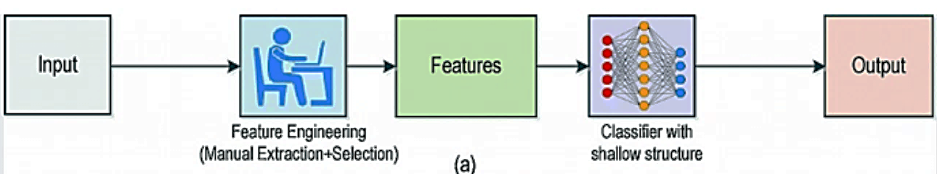
Introduction
Traditional machine learning generally follows this process
Devices → Raw Data → Central Server → Model Training
smartphones
cameras
vehicles
wireless devices
IoT devices
text
images
location and sensing data
spectrum information
environmental measurements
Federated Learning
4/29

Slide 5
Introduction
raw data
financial information
passwords
locations
browsing history
health information
Privacy
bandwidth
energy
storage
network resources
Communication cost
Problems
Scalability
networks may contain millions or billions of devices
Sending data to a distant cloud
processing
Latency
Federated Learning
5/29

Slide 6
Definition and Development
of Federated Learning

Slide 7
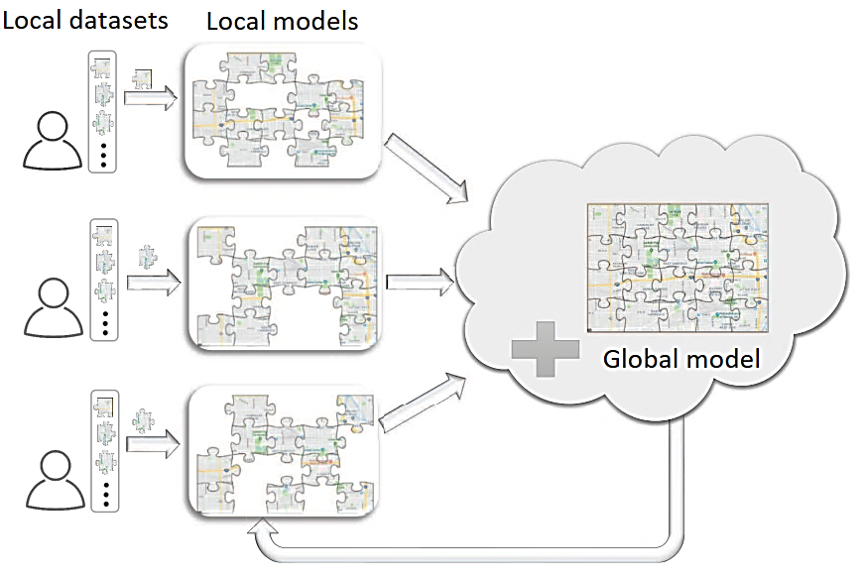
Definition and Development of Federated Learning
What Is Federated Learning?
Local computing
The data stays on the local device
Model transmission
Instead of sending raw data, clients exchange
model-related information
Federated Learning
7/29

Slide 8
Definition and Development of Federated Learning
Why is Federated Learning Useful?
Centralized Machine Learning
Raw Data → Central Server → Training
Data stays locally
Model updates ↔ Server
Federated Learning
Directly sending their privacy-sensitive data to a central server
Federated Learning
8/29

Slide 9
Definition and Development of Federated Learning
Development Idea of Federated Learning
Several companies want to collaboratively train a model
Each company has
limited data
incomplete data
privacy restrictions
If each company trains independently
Model Quality ↓
Why Each organization only sees part of the available information
If they directly combine all data
Privacy Risk ↑
Federated learning tries to solve both problems
Collaboration + Data Privacy
Federated Learning
9/29

Slide 10
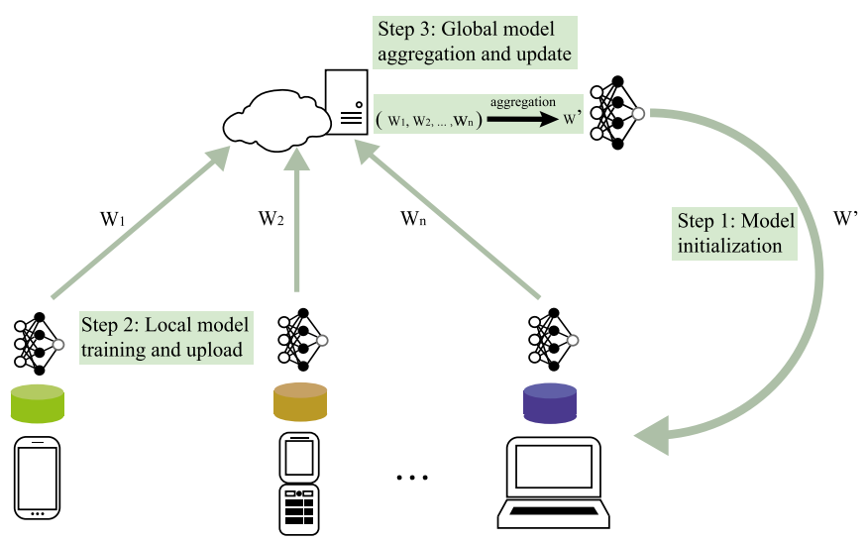
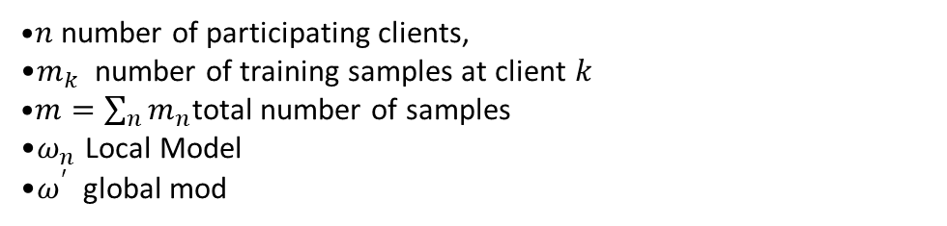

Definition and Development of Federated Learning
Definition of Federated Learning and Federated Averaging
Each client performs local training
$$ω_{t}→ω_{t+1}^{\left(n\right)}$$
The clients then send their updated models to the server
$ω_{t+1}^{\left(1\right)}$, $ω_{t+1}^{\left(2\right)} ,…, ω_{t+1}^{\left(n\right)}$
The server aggregates them
$$ω_{t+1}=\sum_{n=1}^{N}{\frac{m_{n}}{m}ω_{t+1}^{\left(n\right)}}$$
The resulting global model is distributed again
$n$number of participating clients,
$m_{k}$ number of training samples at client $k$
$m=\sum_{n}{m_{n}}$total number of samples
$ω_{n}$ Local Model
$ω^{′}$ global mod
Federated Learning
10/29

Slide 11
Challenges

Slide 12
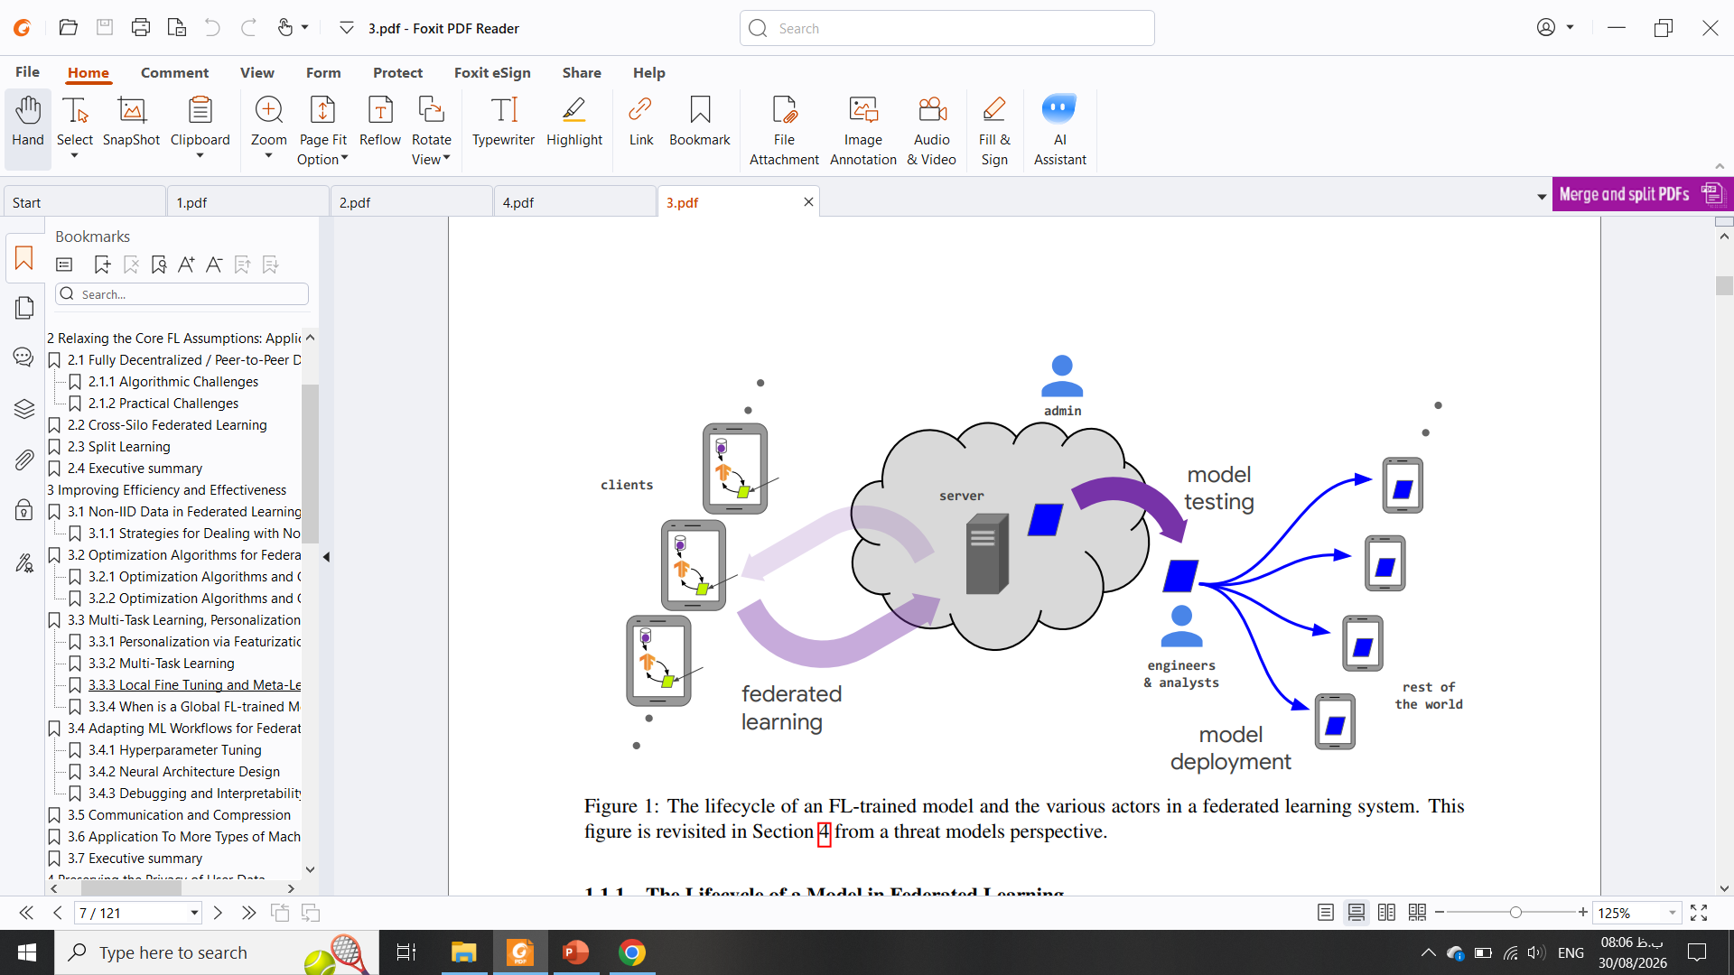
Challenges
Privacy Protection
Privacy ↔ Computational Cost
Communication Cost
Communication with Millions of Devices ↔ Communication Efficiency
System Heterogeneity
Different Hardware + Different Connections + Offline Devices
Unreliable Model Upload
Malicious Attack
Unstable Network
Federated Learning
12/29

Slide 13
Article
Communication-Efficient Learning of Deep Networks from Decentralized Data

Slide 14
Article
Hypothesis
Computation Locally Communication
Train 1 step
↓
Communicate
↓
Train 1 step
↓
Communicate
Train many local steps
↓
Communicate
↓
Train many local steps
↓
Communicate
Brendan McMahan et al., “Communication-Efficient Learning of Deep Networks from Decentralized Data” arXiv, 2023. doi: 10.48550/arXiv.1602.05629.
Federated Learning
14/29

Slide 15
Article
Contributions
Contribution 1
Identifying decentralized learning from mobile devices as an important research direction
Contribution 2
Introducing Federated Averaging (FedAvg)
Contribution 3
Showing robustness to
unbalanced data
non-IID data
and dramatic reductions in communication rounds
Brendan McMahan et al., “Communication-Efficient Learning of Deep Networks from Decentralized Data” arXiv, 2023. doi: 10.48550/arXiv.1602.05629.
Federated Learning
15/29

Slide 16
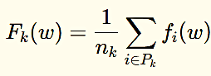
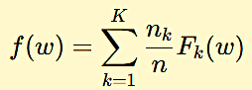



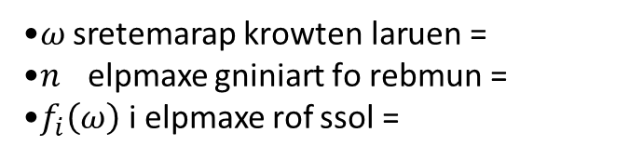

Article
Mathematical Formulation
$$f\left(ω\right)=\frac{1}{n}\sum_{i=1}^{n}{f_{i}\left(ω\right)}$$
$$\min_{ω∈ℝ^{d}} f\left(ω\right)$$
$ω$= neural network parameters
$n$ = number of training example
$f_{i}\left(ω\right)$ = loss for example i
number of examples at client k
set of data points stored at client k
Dividing the dataset across $k$ clients
$$n_{k}={|P}_{k}|$$
Local objective
Global objective
Brendan McMahan et al., “Communication-Efficient Learning of Deep Networks from Decentralized Data” arXiv, 2023. doi: 10.48550/arXiv.1602.05629.
Federated Learning
16/29

Slide 17
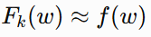
Article
IID vs Non-IID Data
IID local data is approximately representative of the global distribution
IID client have approximately the same proportions
Non-IID
Why is this difficult?
client can optimize perfectly for its own data while moving the model in a direction that is not globally optimal
Brendan McMahan et al., “Communication-Efficient Learning of Deep Networks from Decentralized Data” arXiv, 2023. doi: 10.48550/arXiv.1602.05629.
Federated Learning
17/29

Slide 18
Article
Communication vs Computation
Goal Use more local computation → Reduce communication rounds
Two ways to increase computation
More parallelism
Use more clients in each round.
More local computation
Each participating client performs more SGD updates before communicating.
Brendan McMahan et al., “Communication-Efficient Learning of Deep Networks from Decentralized Data” arXiv, 2023. doi: 10.48550/arXiv.1602.05629.
Federated Learning
18/29

Slide 19
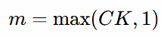
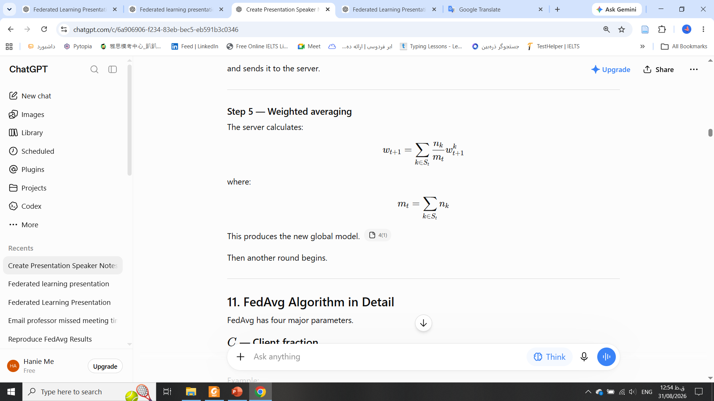


Article
FedAvg Workflow
Step 1 — Client selection
selected fraction
Number of all clients
server sends $ω_{t}$ to every selected client
Step 2 — Model broadcasting
Step 4 — Local models are returned
$$ω_{t+1}^{k}$$
Step 5 — Weighted averaging
Brendan McMahan et al., “Communication-Efficient Learning of Deep Networks from Decentralized Data” arXiv, 2023. doi: 10.48550/arXiv.1602.05629.
Federated Learning
19/29

Slide 20
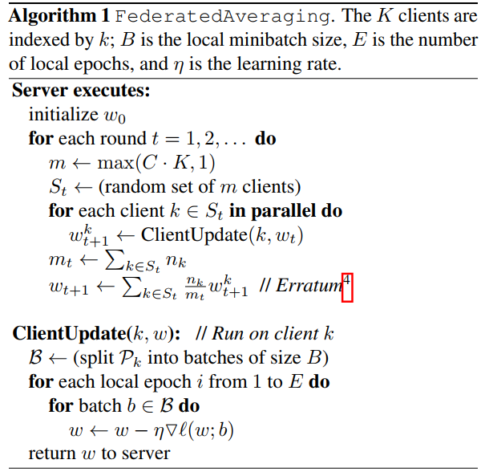
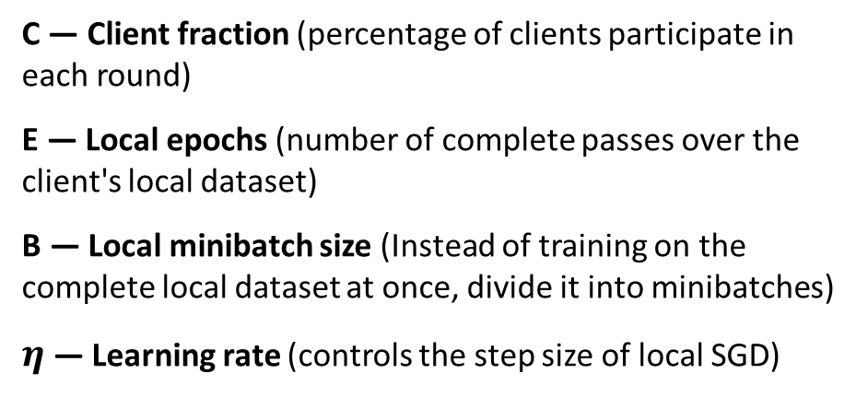
Article
C — Client fraction (percentage of clients participate in each round)
E — Local epochs (number of complete passes over the client's local dataset)
B — Local minibatch size (Instead of training on the complete local dataset at once, divide it into minibatches)
$η$ — Learning rate (controls the step size of local SGD)
Brendan McMahan et al., “Communication-Efficient Learning of Deep Networks from Decentralized Data” arXiv, 2023. doi: 10.48550/arXiv.1602.05629.
Federated Learning
20/29

Slide 21
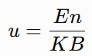
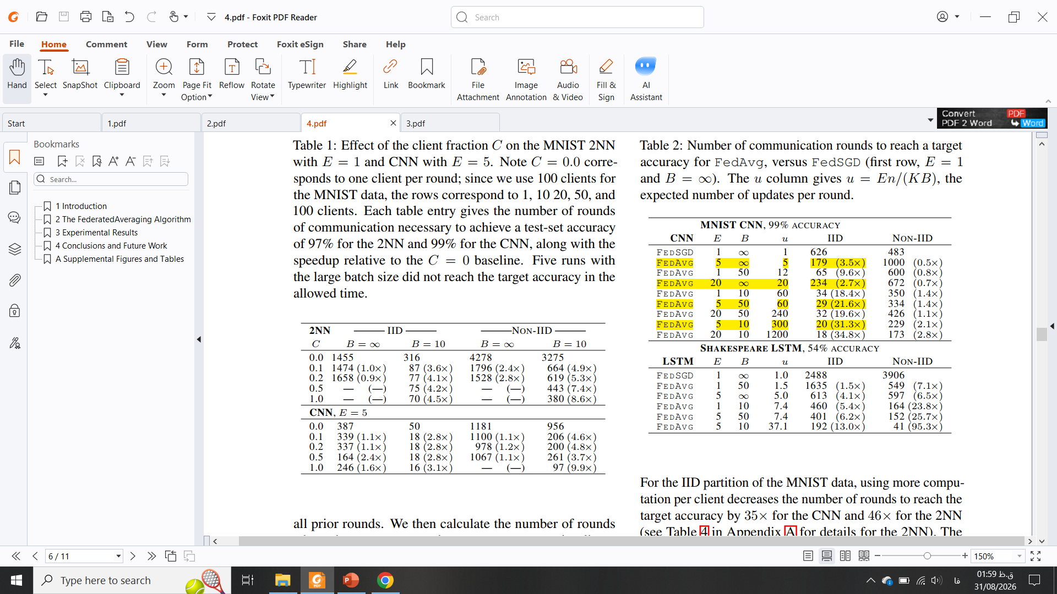
Article
Effect of Local Computation
Number of local updates per client per round
E = local epochs
n = total number of examples
K = number of clients
B = minibatch size
More local computation ⇒ Fewer communication rounds
E↑ ⇒ communication↓
E↑↑ ⇒ possible instability
Very large numbers of local epochs
plateauing
divergence
Brendan McMahan et al., “Communication-Efficient Learning of Deep Networks from Decentralized Data” arXiv, 2023. doi: 10.48550/arXiv.1602.05629.
Federated Learning
21/29

Slide 22
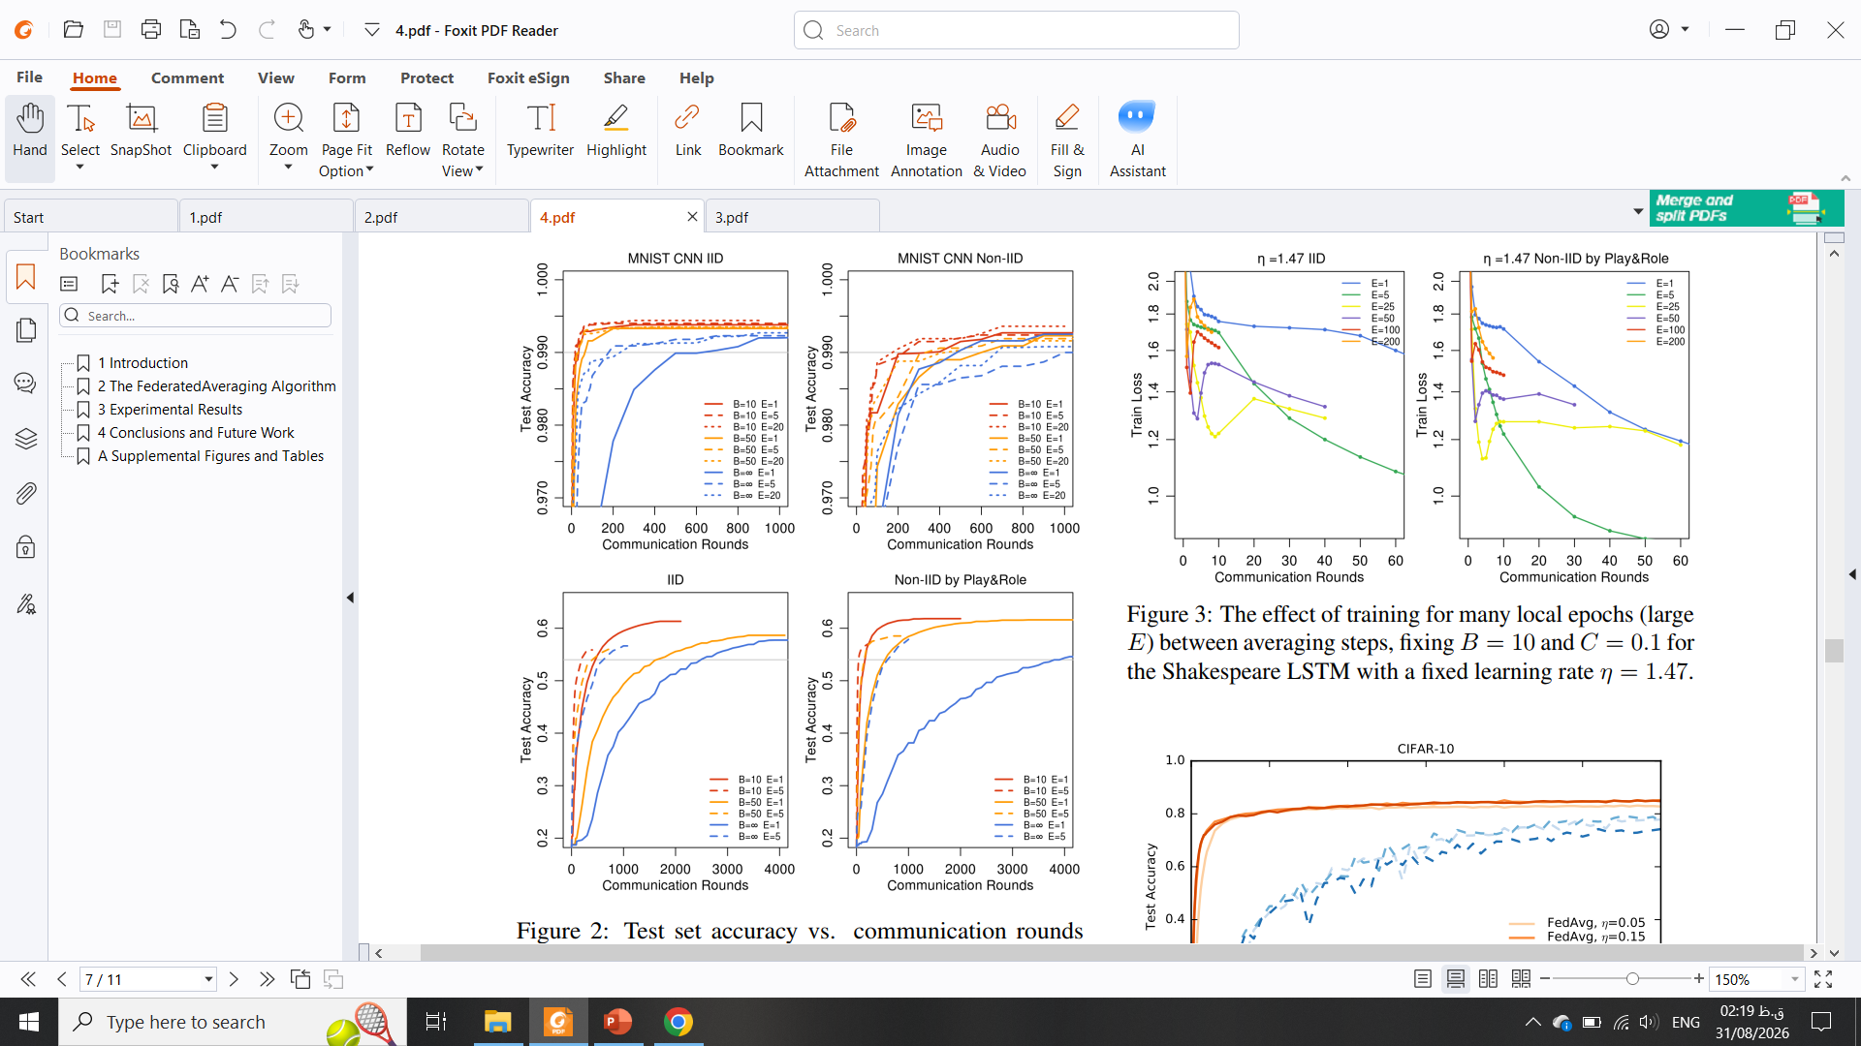
Article
23× Communication Reduction Result
FedSGD
Required 820 communication rounds to achieve 10.5% test accuracy.
FedAvg
Required only 35 communication rounds to achieve the same 10.5% test accuracy.
820 / 35 ≈ 23.4
approximately 23× fewer communication rounds
Brendan McMahan et al., “Communication-Efficient Learning of Deep Networks from Decentralized Data” arXiv, 2023. doi: 10.48550/arXiv.1602.05629.
Federated Learning
22/29

Slide 23
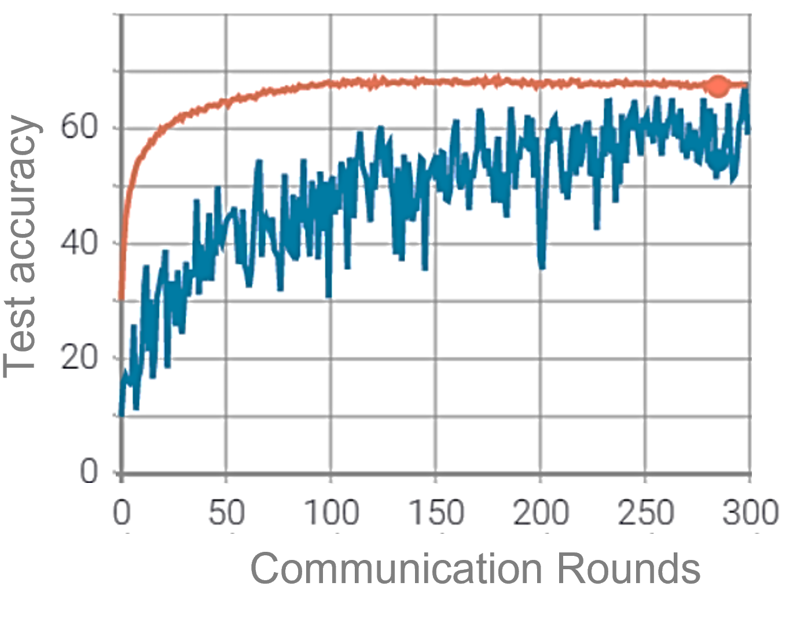
Article
MNIST | CIFAR 10
98.87 % | 68.70 % | IID
98.05 % | 68.11 % | Non-IID
Model CNN, Dataset CIFAR or MNIST, epochs 100 and 300, $η$ 0.01, local-ep 5, local bs 32
Federated Learning
23/29

Slide 24
Future works and Conclusion

Slide 25
Future works and Conclusion
Strengths
Simplicity
Communication efficiency
Non-IID robustness
Model diversity
Practical motivation
Limitations
Privacy is not guaranteed
Client heterogeneity
Synchronous operation
Non-IID remains difficult
Hyperparameter selection
Federated Learning
25/29

Slide 26
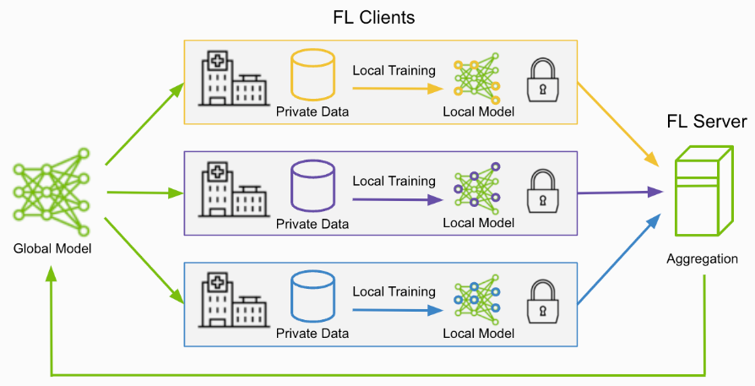
Future works and Conclusion
Future Directions
1. Privacy
make the training process mathematically private
2. Security
defend against
malicious clients
poisoned updates
model inversion
inference attacks
3. Communication
reduce
model size
uplink traffic
downlink traffic
number of rounds
4. Heterogeneity
different device capabilities
different network conditions
different local datasets
Federated Learning
26/29

Slide 27
References
S. Niknam, H. S. Dhillon and J. H. Reed, "Federated Learning for Wireless Communications: Motivation, Opportunities, and Challenges," in IEEE Communications Magazine, vol. 58, no. 6, pp. 46-51, June 2020, doi: 10.1109/MCOM.001.1900461.
Chen Zhang, Yu Xie, Hang Bai, Bin Yu, Weihong Li, Yuan Gao, ‘’A survey on federated,’’ in sciencedirect, Volume 216, 2021, ISSN 0950-7051, doi: 10.1016/j.knosys.2021.106775.
Peter Kairouz, et all., ‘’ Advances and Open Problems in Federated Learning, ‘’ arXiv, 2021, doi: 10.48550/arXiv.1912.04977.
Brendan McMahan et al., “Communication-Efficient Learning of Deep Networks from Decentralized Data” arXiv, 2023, doi: 10.48550/arXiv.1602.05629.
Federated Learning
27/29

Slide 28
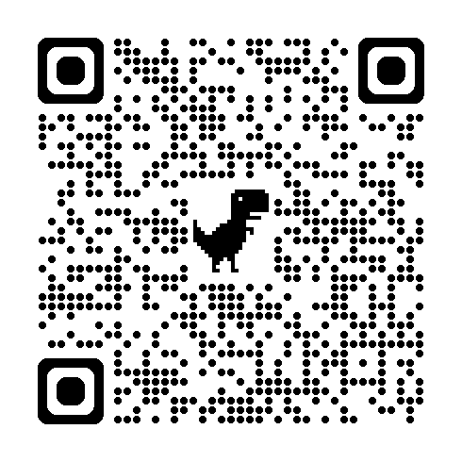
Quiz
Federated Learning
28/29

Slide 29
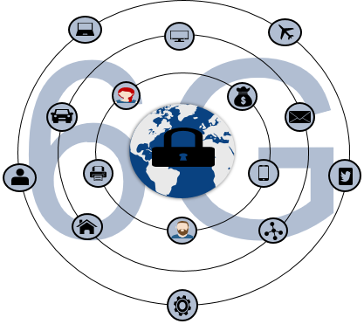
Thank you for your attention

